Slide 1

OPERATION ANALYTICS AND INVESTIGATING METRIC SPIKE

Slide 2

PROJECT DESCRIPTION
Operational Analytics is a crucial process that involves analyzing a company's end-to-end operations. This analysis helps identify areas for improvement within the company. As a Data Analyst, you'll work closely with various teams, such as operations, support, and marketing, helping them derive valuable insights from the data they collect.
One of the key aspects of Operational Analytics is investigating metric spikes. This involves understanding and explaining sudden changes in key metrics, such as a dip in daily user engagement or a drop in sales. As a Data Analyst, you'll need to answer these questions daily, making it crucial to understand how to investigate these metric spikes.

Slide 3
APPROACH
In this project different datasets and tables are being used to analyze the data and provide valuable insights that can help improve the company's operations and understand sudden changes in key metrics.
Data cleaning, importing the data is done to further analyse the data to perform the given queries to get the insights which help the operations, support, and marketing, teams to identify areas for improvement within the company.

Slide 4



TECH-STACK USED
Microsoft Office 2019 is used
MS Excel is used to clean, analze and import the data to MY SQL to perform tasks to get insights
MySQL Workbench 8.0 Community Version
It is a relational database management system used to create the database and perform queries
Microsoft PowerPoint 2019
It is used for documenting the insights and presentation

Slide 5
CASE STUDY 1: JOB DATA ANALYSIS
Here we will be working with a table named job_data with the following columns:
job_id: Unique identifier of jobs
actor_id: Unique identifier of actor
event: The type of event (decision/skip/transfer).
language: The Language of the content
time_spent: Time spent to review the job in seconds.
org: The Organization of the actor
ds: The date in the format yyyy/mm/dd (stored as text).

Slide 6
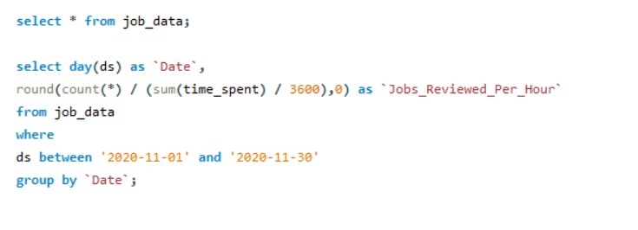
INSIGHTS:
QUERY 1:
Below is the SQL query to calculate the number of jobs reviewed per hour for each day in November 2020.

Slide 7
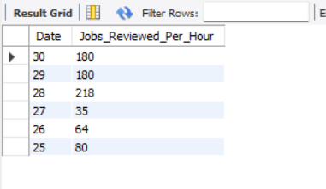
RESULT:
Above are the number of jobs reviewed per hour for each day in the month of November 2020 , which varies throughout November, which could indicate potential trends or anomalies.
More number of jobs are reviewed on 28th of November.

Slide 8
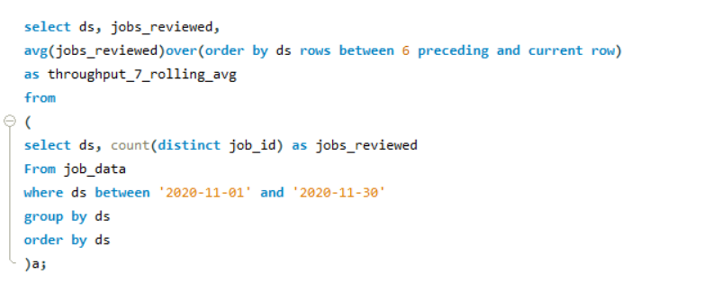
QUERY 2:
Below is the SQL query to find the 7-day rolling average of throughput.

Slide 9
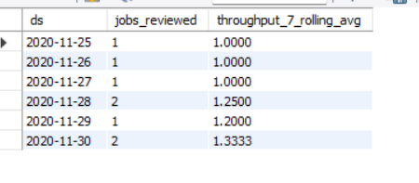
RESULT:
Using the 7-day rolling average for throughput is preferred over the daily metric to observe trends without being influenced by daily fluctuations.
7 day rolling average provides a smoother view of data trends, helping to identify long-term patterns.

Slide 10
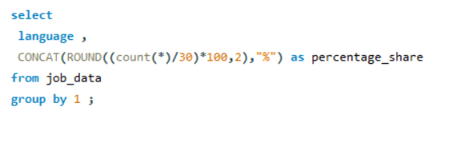
QUERY 3:
  Below is the SQL query to get the percentage share of each language in the last 30 days.

Slide 11
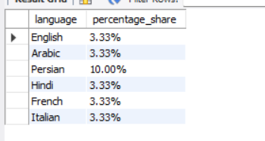
RESULT:
Language distribution is relatively balanced
The Persian language has the highest share of 10.00 percent.

Slide 12
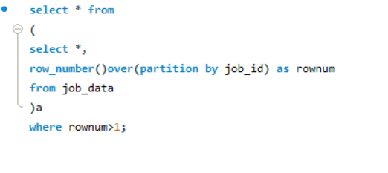
QUERY 4:
Below SQL query helps to identify the duplicate rows in the data.

Slide 13
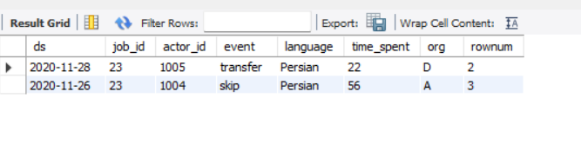
RESULT:
Above are the are two duplicate rows if we partition the data by job_id.
Data validation mechanisms need to be implemented to prevent duplicates and maintain data integrity.

Slide 14
CASE STUDY 2: INVESTIGATING METRIC SPIKE
Here will be working with three tables:
users: Contains one row per user, with descriptive information about that user’s account.
events: Contains one row per event, where an event is an action that a user has taken (e.g., login, messaging, search).
email_events: Contains events specific to the sending of emails.
The 3 datasets are cleaned for blanks fields and then imported to MYSQL workbench to further perform the queries.

Slide 15
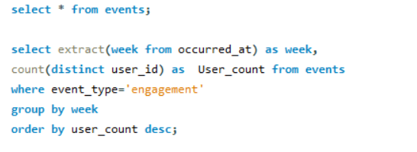
INSIGHTS:
QUERY 1:
Below query gives the weekly user engagement to measure the activeness of users on a weekly basis.

Slide 16
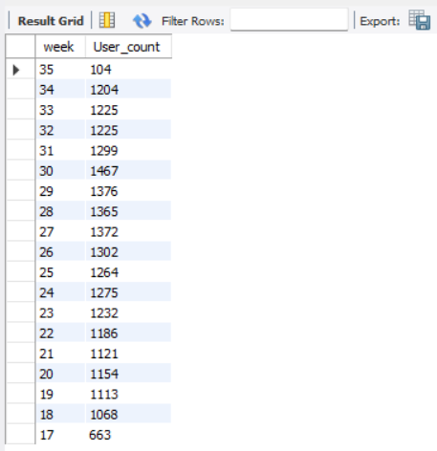
RESULT:
The weekly user engagement increased from week 18th to week 30th and then the user count started decreasing.

Slide 17
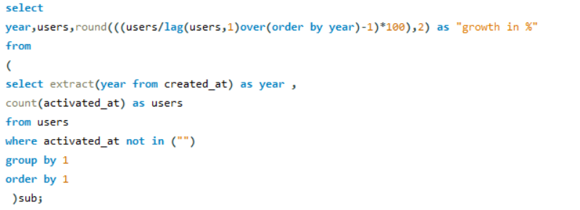
QUERY 2:
Below query gives growth of users over time for a product.

Slide 18
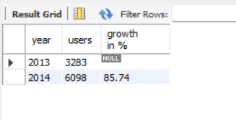
RESULT:
Above results shows that in the year 2014 the growth rate of users has increased and it is 85.74 %.

Slide 19
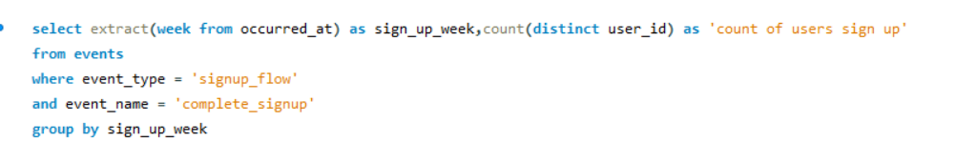
QUERY 3:
Below query is performed to analyze the retention of users on a weekly basis after signing up for a product.

Slide 20
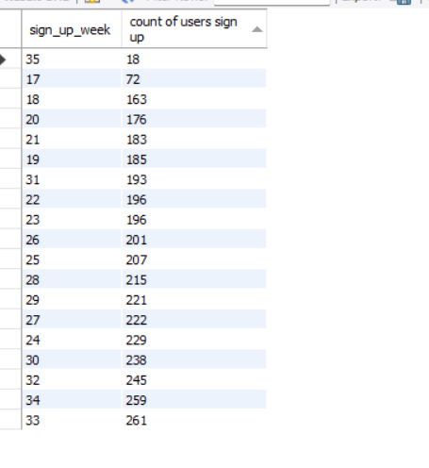
RESULT:
About result gives the counts of user's retention on a weekly basis after signing up for a product.
After the week 33 the count of users sign up has decreased in the week 35.

Slide 21
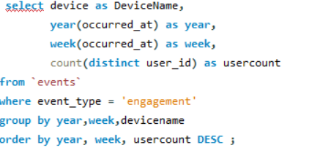
QUERY 4:
Below query measures the activeness of users on a weekly basis per device.

Slide 22
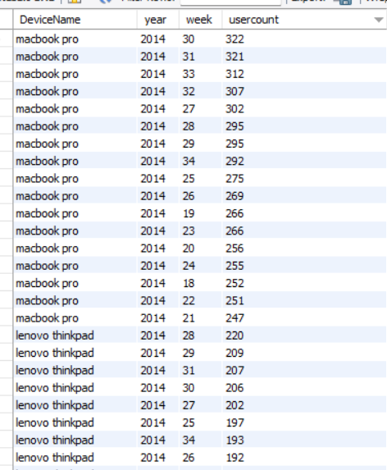
RESULT:
Activeness of users on weekly basis per device ,most is for MacBook pro and next is for Lenovo ThinkPad.

Slide 23
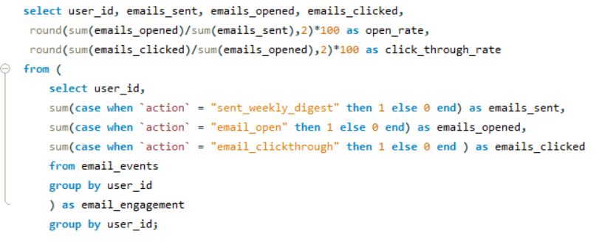

QUERY 5:
Below SQL query is used to analyze how the users are engaging with the email service.

Slide 24
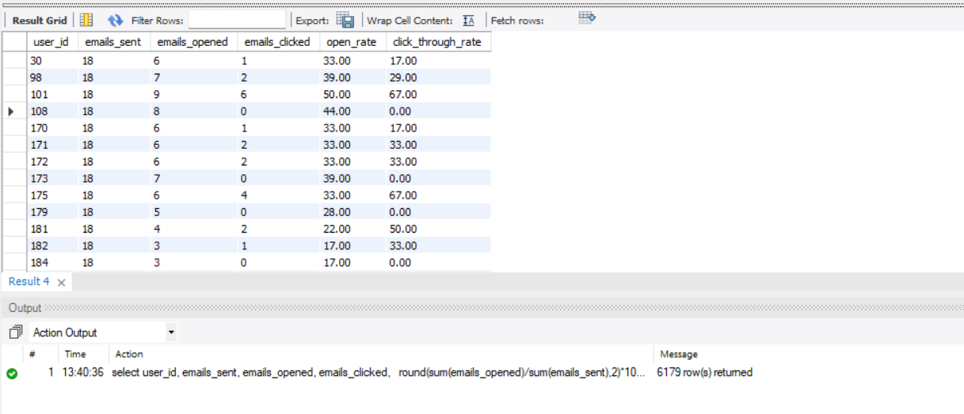
RESULT:
Above queries shows count of user's engagement with emails and how the users are engaged with the email service. There are total of 6179 rows .

Slide 25
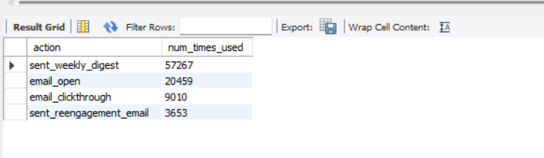
From the above output we can find that users are interested in email services and are actively engaged with emails services.

Slide 26
Drive Link:
  https://docs.google.com/presentation/d/1sKJh2Tx81xPTw1WK_npUcry8f3e_MyZF/edit?usp=drive_link&ouid=115113743333769008943&rtpof=true&sd=true

Slide 27
THANK YOU

